Slide 1
Discrete Models of Sampled-Data Systems
  Transfer function representations
  State-space representations
  Relation between state-space and transfer function representations
  Poles and zeros from state-space representations

Slide 2
Discrete Transfer Function Models of Sampled-Data Systems
How to compute discrete T.F. from u(kT) to y(kT) ?
Assume D/A is a ZOH device:
  Accepts a sample u(kT) at t = kT and then holds its output at this value until the next sample is accepted at t = kT + T.
  Input u(t) to plant G(s) is a piecewise constant signal.

Slide 3
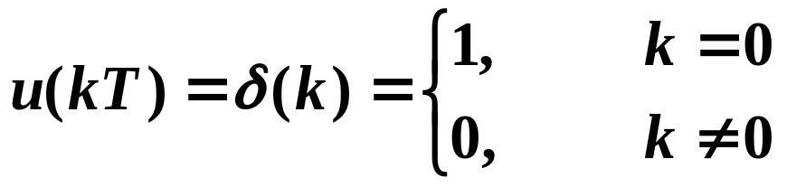
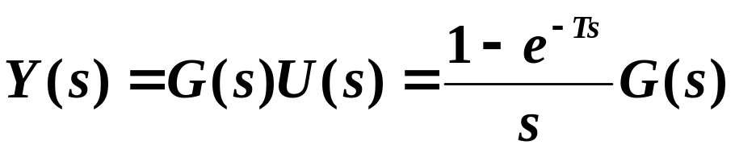
From discussion before, G(z) is just the Z-transform of the pulse response:

Slide 4
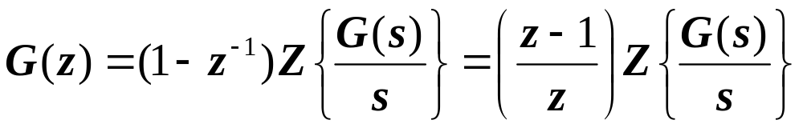

Slide 5
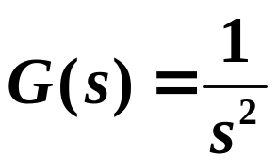
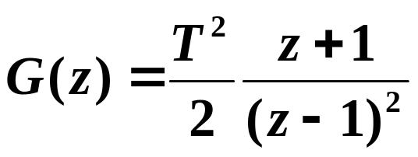
Example
What is G(z) ?

Slide 6
Discrete State-Space Models
of Sampled-Data Systems
How to find discrete state-space model of system from u(kT) to y(kT) ?
Let’s solve the continuous-time state equations:
  Two steps:
    Homogeneous solution
    Particular solution

Slide 7
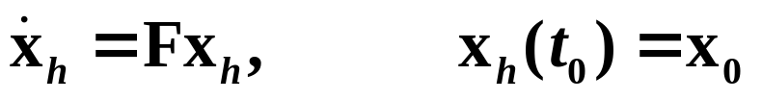
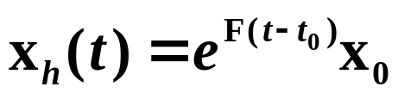
Homogeneous Solution
It can be shown that the solution is unique.

Slide 8
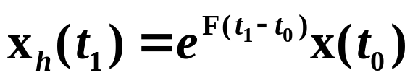

Inverse of Matrix Exponential

Slide 9
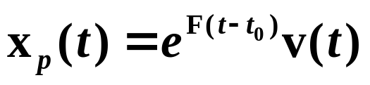
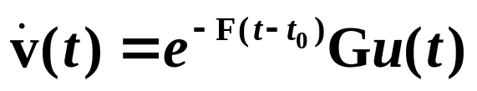
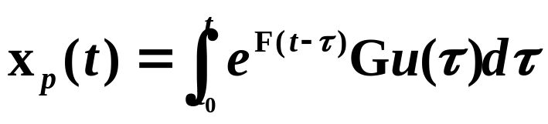
Particular Solution
Variation of parameters method
Given above, guess a solution of the form
Substitute into the state equation:

Slide 10
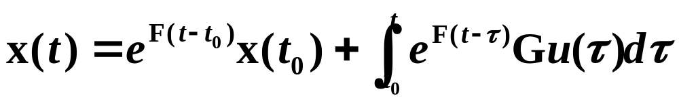
Total solution is the sum of the homogeneous and particular solutions:
Want to use this solution over one sample period to find discrete-time state-space difference equation:
  This equation is independent of the type of hold used for u(t), since u(t) is represented in its general form.

Slide 11
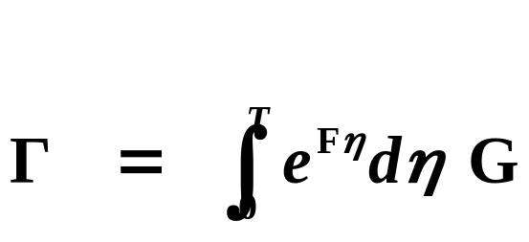
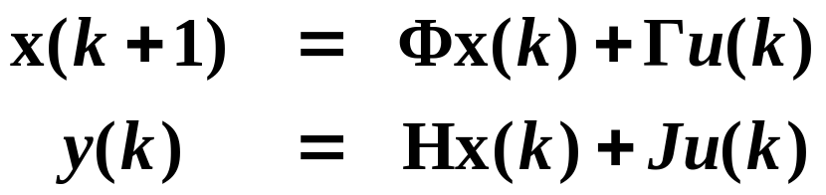
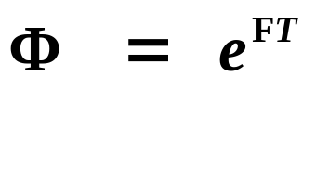
If we assume that a ZOH is used (as is commonly done):
where

Slide 12
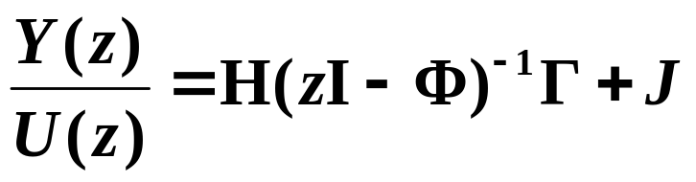
Relation Between State-Space Difference Equation and Discrete-Time Transfer Function
where

Slide 13





Example
D/A
A/D
Find discrete-time state-space representation of sampled data system.
Find discrete-time transfer function from the state-space representation.

Slide 14
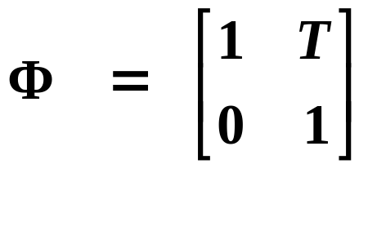
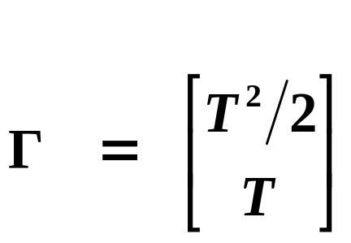

Slide 15
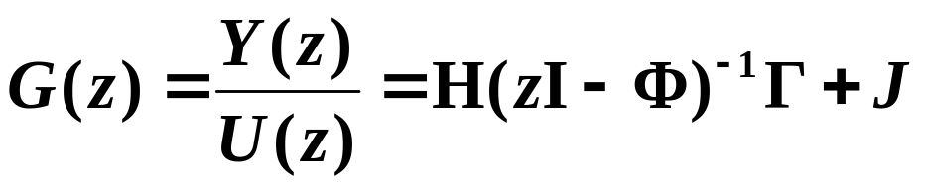

Slide 16

Poles and Zeros from State-Space Models
A pole of a discrete-time system is a value of z such that the system (or difference equation) has a nontrivial solution when the forcing input u = 0.

Slide 17
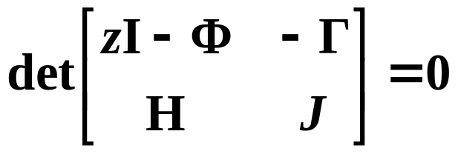
A zero of a discrete-time system is a value of z such that the system output y = 0 even if the initial state x(t₀) and the forcing input u are nonzero.

Slide 18




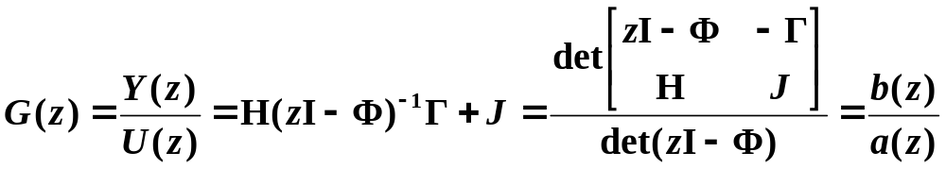
Example
D/A
A/D

